Slide 1


KRAKEN QGIS PLUGIN • USER MANUAL
Timing Advance Coverage Analyzer
Interactive GIS tool for detecting cell overshooting, analyzing TA distribution arrays, and visualizing sector ranges in QGIS.
Multi Vendor
Pareto Analytic
Auto-Styling
ZTE & Huawei LTE Support
TA90 & Avg Range Detection
Dynamic Polygon & Arc Render
Kraken © 2026 | akanipatra@gmail.com

Slide 2
STEP 01 • INTERACTIVE MAP TOOL
Target Cell Selection Workflow
01
02
03
Activate TA Map Tool
Canvas Interaction
Auto-Clean & Render
Select the TA Tool icon from the Kraken Toolbar to switch your cursor to selection mode.
Click any cell wedge on the map canvas. The tool identifies the nearest cell feature within a dynamic search radius.
Previous overlay charts and GIS layers are automatically removed before rendering new cell metrics.
Cursor changes to Pointing Hand
Auto-detects Cell, Azimuth & TA Data
Prevents GIS layer cluttering
Kraken © 2026 | akanipatra@gmail.com

Slide 3

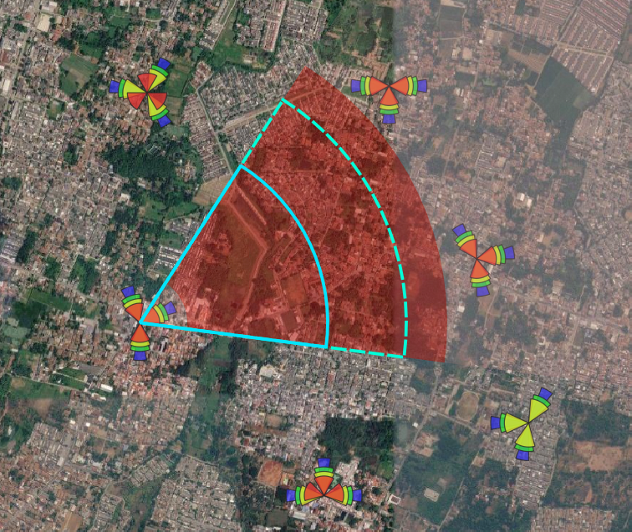
STEP 02 • SPATIAL GIS REPRESENTATION
Coverage Polygon Layers
TA Distribution Layer (TA_Dist)
Graduated 5-step red color opacity based on sample distribution share in each distance bin.
Average TA Arc (Solid Cyan)
Represents the weighted average distance of the serving cell's user traffic.
TA90 Outer Limit (Dashed Cyan)
Indicates 90th percentile coverage boundary to immediately spotlight overshooting distance.
Kraken © 2026 | akanipatra@gmail.com

Slide 4

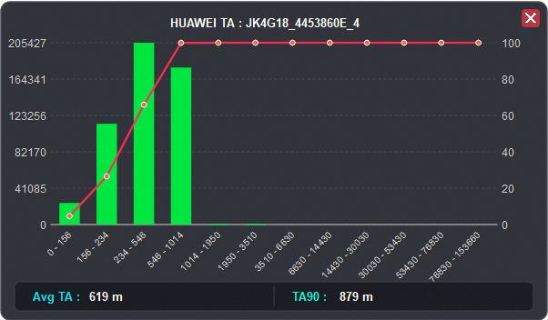
STEP 03 • ANALYTICS OVERLAY
Interactive Pareto Chart Overlay
Green Histogram Bars
Displays raw sample counts per vendor-specific distance bin (e.g., 234m - 546m).
Red Pareto Curve
Cumulative percentage trajectory showing traffic concentration buildup.
Hover Tooltips & Close Button
Hover points/bars for exact counts and percentages. Click "✕" to dismiss overlay.
Kraken © 2026 | akanipatra@gmail.com

Slide 5
REFERENCE • DISTANCE SPECS
Vendor Bin Mapping Reference
ZTE Distance Profile
Max 20 km (TA16)
HUAWEI Distance Profile
Extended Range
Fine-grained inner bins for dense urban optimization.
Broader range grouping suitable for macro and rural cells.
Bin | Range (m) | Bin | Range (m)
TA1 | 0 - 78m | TA5 | 546 - 703m
TA2 | 78 - 234m | TA6 | 703 - 859m
TA3 | 234 - 390m | TA7 | 859 - 1015m
TA4 | 390 - 546m | TA8 | 1015 - 1562m
Bin | Range (m) | Bin | Range (m)
TA1 | 0 - 156m | TA5 | 1014 - 1950m
TA2 | 156 - 234m | TA6 | 1950 - 3510m
TA3 | 234 - 546m | TA7 | 3510 - 6630m
TA4 | 546 - 1014m | TA8 | 6630 - 14430m
Kraken © 2026 | akanipatra@gmail.com

